Slide 1
Dating App Google Play Reviews
Breakout Room #4
Ellen, Ryan, Lizzy, Nii, Andrew

Slide 2



Data Sets from Kaggle
Dating App, Like For Reals
Dating App
Dating/Making Friends App

Slide 3
127,082 Reviews
53,677 Reviews
65,536 Reviews

Slide 4
Data Wrangling
01
02
03
Data Cleaning
Pull CSV files into Pandas
Remove Duplicates
Drop unnecessary columns
Concatenate Username and Image for a unique ID
Joining
Merge three data frames in postgreSQL where Username and User Image are the same
Analysis
Sum rating totals to find the top rated app between the three
Notes:
Types of data wrangling:
Cleaning
Joining

Slide 5
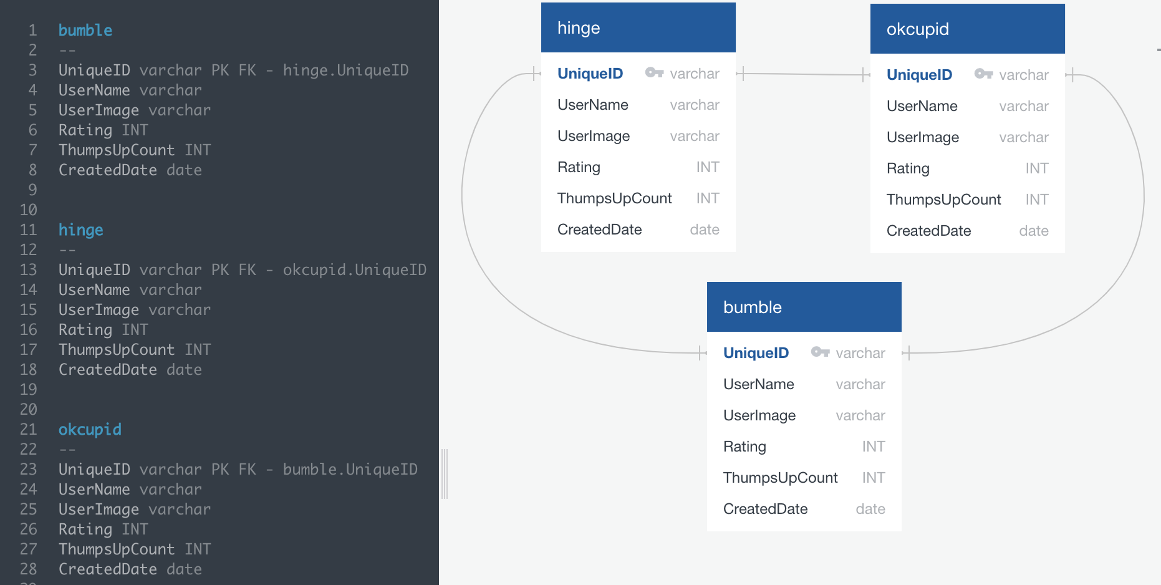
Schema

Slide 6
843
Unique Raters!

Slide 7
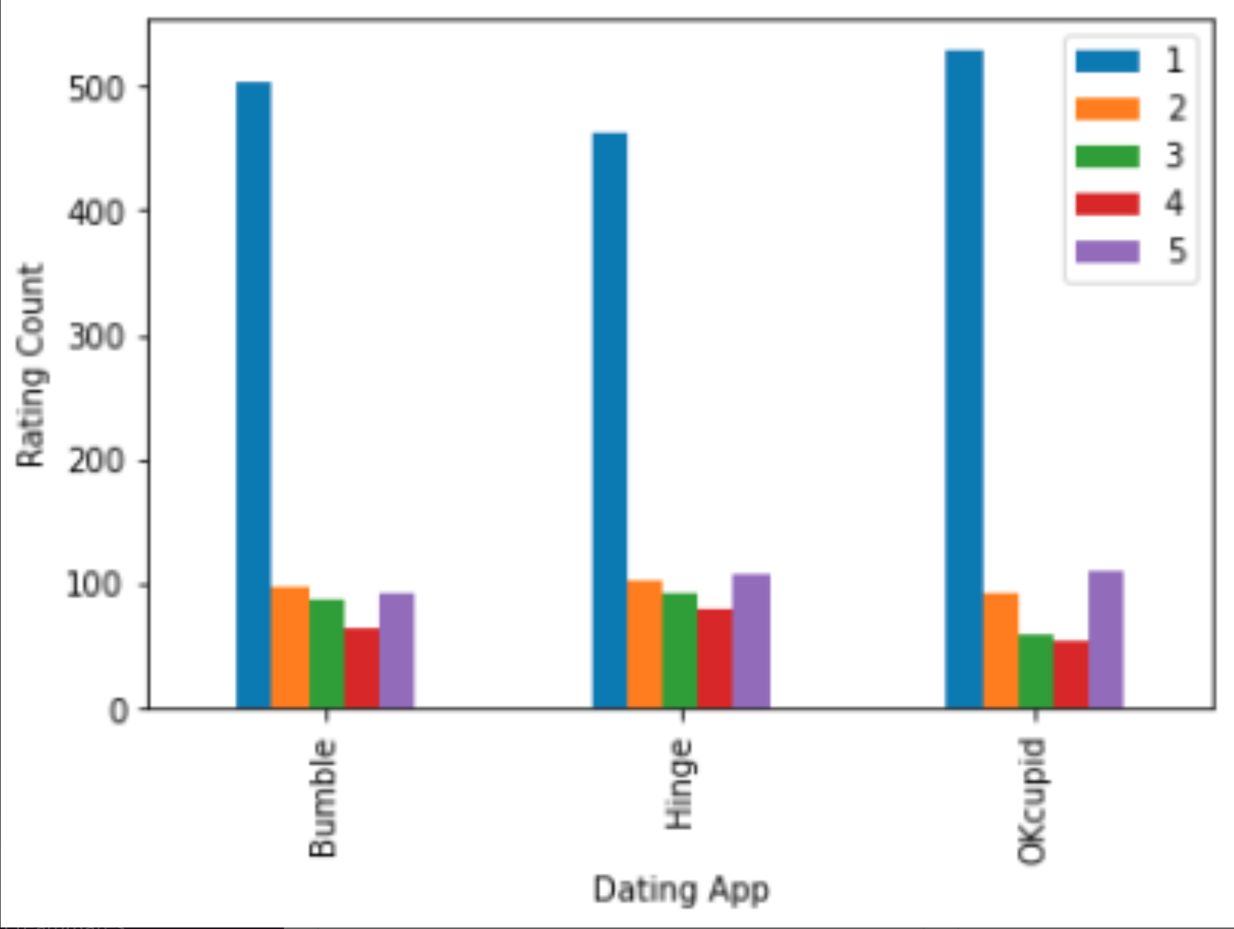
Distribution
843
Unique Raters!

Slide 8
Awards
1799
Avg Rating 2.13
1671
Avg Rating 1.98
1655
Avg Rating 1.96

Slide 9
Thanks!
This project was brought to you by Geico. Save 15% on your next car insurance!

